Slide 1
Development & Communications Board Presentation
Rebecca Mauldin, Director of Development & Communications
Natalie Kinsinger, Donor Relations & Community Engagement Officer

Slide 2
Recent Successes… and something to look forward to
Valentine’s Day Awareness Campaign
Everett Herald Article
Goddard School Regional Drive

Slide 3
Valentine’s Day Campaign

Slide 4
Valentine’s Day Results
Radio (1 ad)
Run 2/10 to 2/14, focused on highest listening times
Listening Audience
45,000 Radio Listeners
10,000+ Streaming Listeners
Social Media (2 posts)
4,048 people reached
708 reactions
23 Shares by individuals and businesses (including KRKO/KXA)
827 viewings of all or a portion of the video
Print (Valentine’s card)
Personalized messages to 100 individual and corporate donors
Email (2,107 unique addresses)
25% Open rate
89 Link clicks
64 Unique video views

Slide 5
Title
“ChildStrive has new digs and a broader mission than in the past, but its goal remains the same: Give young children a great start in life.”
Everett Herald News Article
Reach 362,000 readers
117,000 directly on the Herald website
245,000 via social
Everett Post Facebook Live coverage
Reach 6,370 viewers

Slide 6
Title
Selected ChildStrive as the beneficiary of the Snohomish Goddard School donation drive for the second year in a row
Drive will run in conjunction with their art fair on Saturday, April 25
Regional Donation Drive focused on Early Intervention Services
All Goddard Schools in Snohomish and King Counties will participate and raise funds to benefit an early intervention program near them
The national office will also be promoting the campaign
Increased promotional opportunities due to regional focus

Slide 7
Looking Back
Not a major investment area for ChildStrive
1 Development & 1 Program Marketing position
Heavy Event Focus with a fall appeal
Database is heavy event donors.
Vacant positions for 6+ months prior to my start, no formal donor stewardship

Slide 8
Today’s Team
Rebecca started in March 2017
Took on both the Development & Marketing
Focused on Luncheon
New Brand recognition/awareness/consistency/credibility
Hayley joined in Oct 2018.
Increase social media capacity, helped handle growing logistics, events, and community presence.
Natalie joined in Jan 2019
Focused on donor engagement
Rebecca was on broken-up Maternity Leave for 14 weeks – up to a 3 person team in the fall when she returned full-time.
The grants program is managed by Jim and Terry and falls outside of the Development Department.

Slide 9
Challenges
ChildStrive’s donor pipeline has been almost entirely event focused
Lack of historical investment in the integrity of donor data
Development holds many internal program and internal communication admin pieces
Program/client focused community events
Program flyers
Internal and Client document printing
We are a very small team.

Slide 10
The Plan
New database software!
Contracted with a professional to get an initial repair sweep done.
Continued clean-up and repair will happen as we use the data.
Regular dashboard with information on our donor base.
Re-homing non-development focused tasks
We’re a small team… so we’ve got to get the community working for us!

Slide 11
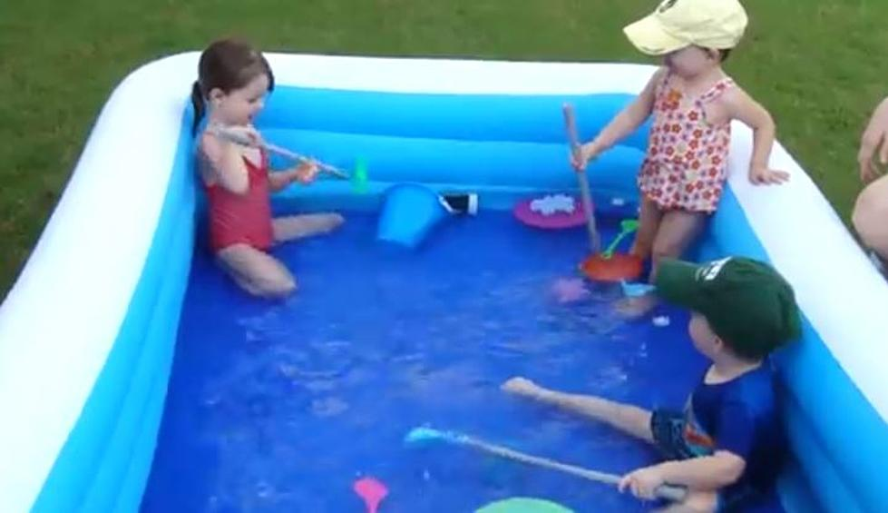
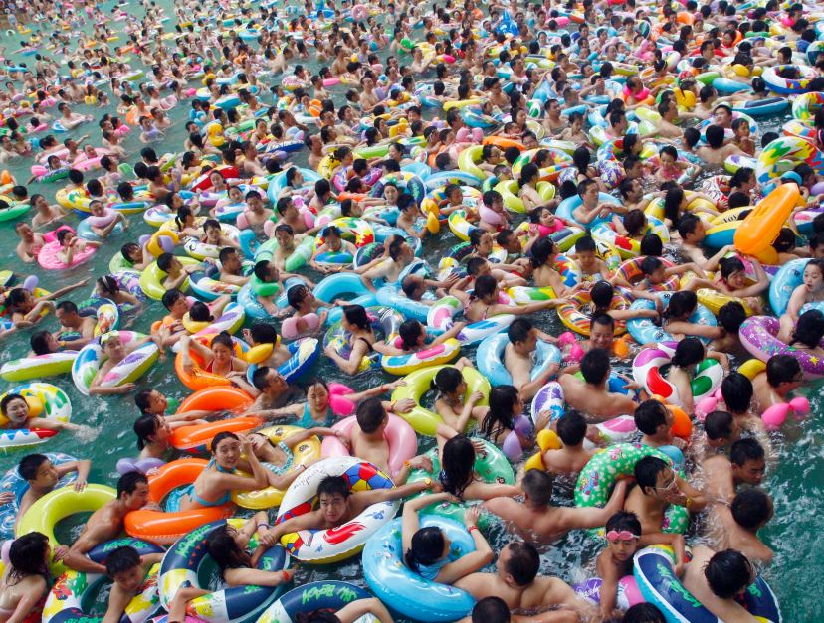
ChildStrive’s Donor Pool
What We Have…
What We Need…

Slide 12
Army of the Engaged!

Slide 13
Increase Dollars Raised
Donors
(Returning / New / Lapsing)
Sponsors
(Returning / New / Lapsing)
Engagement
Volunteers
(Returning / New)
Drive Hosts
(Returning / New)
Event Attendance
(Returning / New)
Donor Communications
Agency Updates to Donors
Direct Supporter Interactions
(Current / Prospective)
PR
Media Mentions
Community Speaker Events
Social Media Engagements

Slide 14
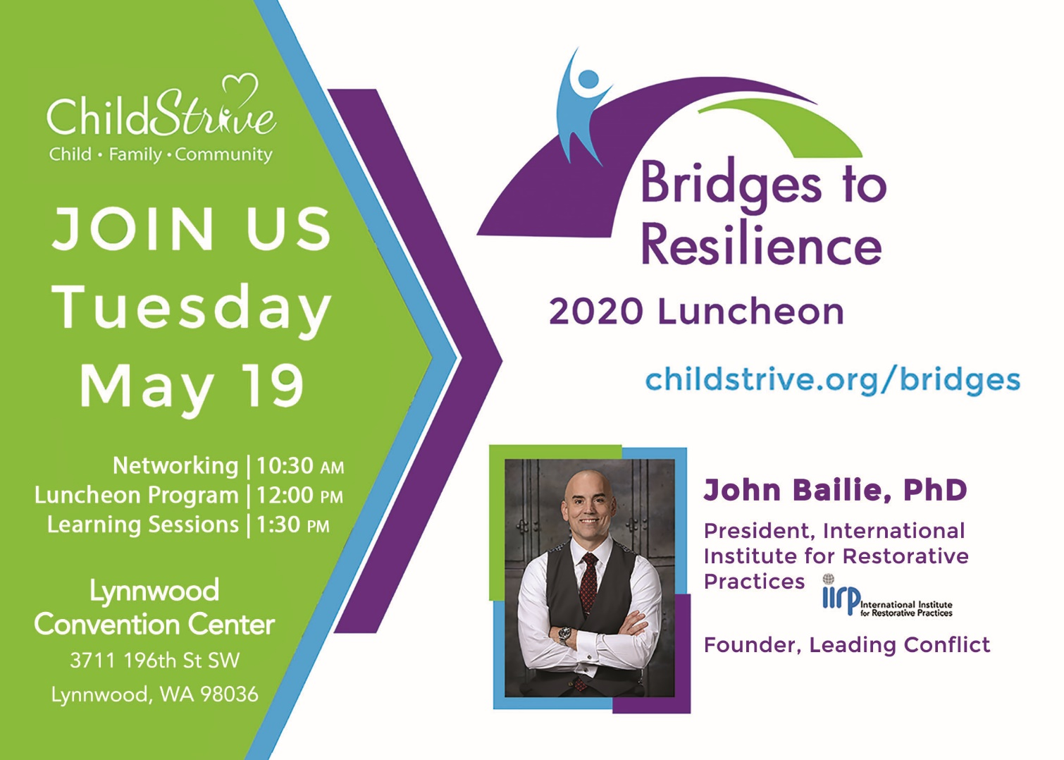
May Luncheon

Slide 15
Messaging
Unified message of urgent needs for families & kids
Hit on the growth of the area, and how vulnerable families will need more support and there will be more families.
Ensure that the calls for urgency pull on heart strings and make people feel the urgency and the impact
Be clear on our impact through numbers and stories and connect people back to the kids/families
Bookmarks for supporters to sign and send a message of encouragement and to support to families. These will be given as part of an alumni packet sent to families after they transition out.

Slide 16
Beyond the Luncheon
Engagement opportunities throughout the year:
Program information nights:
Clever Sprouts Preschool program and play & learn groups
Late June at our Casino Road location
Nurse Family Partnership and Intake
July 16 at our Lynnwood branch
Early Intervention and Parents As Teachers
Early fall at our Everett Mall Way location
Donation Drives
Lunch and Learns / Speaker Events
Monthly Volunteer Days

Slide 17
Establish Personal Goals
Update us on what is happening in your work!
Interactions, notes, follow-ups, leads, needs, etc.
Table Captain at the Luncheon!
Invite people to things!
Program nights, volunteer days, host drives or engage in other’s drives, private tours/information meetings, etc.

Slide 18
What do you need from us?

